Slide 1

NE 591-Technical Paper Project
Multiscale modeling of fission gas behavior in U₃Si₂ under LWR conditions
T. Barani et al., Journal of Nuclear Materials, 2019. 522: p. 97-110
Angelica M. Lopez Morales

Slide 2
Introduction
The goal of this study was to proposed multiscale model of fission gas swelling and release in U₃Si₂ under LWR conditions for application in engineering fuel analysis
The model includes components for intra-granular and inter-granular behavior of fission gases
Intra-granular: Describes the evolution during irradiation of the average size and number density of intra-granular fission gas bubbles coupled to gas diffusion to grain boundaries.
Inter-granular: Include precipitation, growth, and coalescence of bubbles contributing to fuel swelling, and the eventual thermal fission gas release (FGR).
Challenge: Experimentally derived values for important modeling parameters, such as the lattice diffusion coefficient of gas atoms and the rate of irradiation-induced re-solution of gas atoms from intra-granular bubbles, are unavailable for U₃Si₂ under LWR condition.
Density Functional Theory (DFT) and Binary Collision Approximation (BCA) calculations were used to estimate these variables

Slide 3


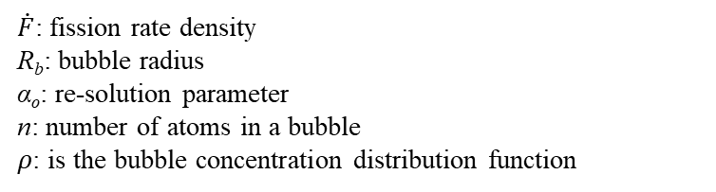
Experimental Procedure
Density functional theory calculations
v: attempt frequency
a: jump distance
Z: number of sites available for the Xe atom or vacancy to jump to
G_{a}: activation free energy given by the migration enthalpy and the defect formation and binding energies and entropies
The resulting activation energies and preexponential factors were approximated based on experience from other materials such as UO₂
Intra-granular re-solution calculation
Homogeneous Model
Gas atoms being knocked out of a gas bubble due to a collision with the fission fragments.
The total re-solution rate at which atoms are knocked back into the fuel was calculated by,
$\dot{F}$: fission rate density
R_{b}: bubble radius
α_{o}: re-solution parameter
n: number of atoms in a bubble
𝜌: is the bubble concentration distribution function

Slide 4
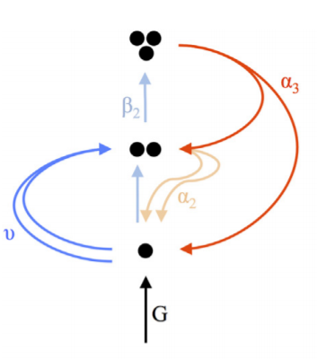



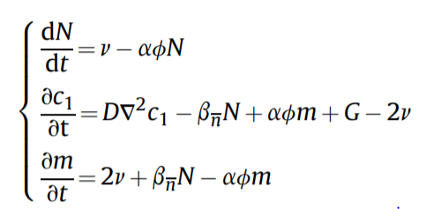
Experimental Procedure
Intra-granular fission gas behavior model
G: production rate of gas atoms
ν: nucleation rate of fission gas dimers →
D is the diffusion coefficient of single gas atoms in the fuel matrix, R_{sg} is the radius of a gas atom, and f_{n} is the nucleation factor.
$β_{n}$: probability per second that a single atom is trapped by a cluster containing n atoms
D is the single gas atom diffusion coefficient in the fuel matrix, R_{n} is the cluster size, and c₁ is the concentration of atoms in the matrix
α_{n} represents the probability per second that an atom is re-solved from a cluster containing n atoms
α₀ is a coefficient, which can in principle depend on the cluster size
Considering that process occurs faster than the growth process,
N: total concentration of bubbles
ɸ= c₂/N represents the fraction of dimers over the total number of bubbles
m: total concentration of gas in bubbles

Slide 5
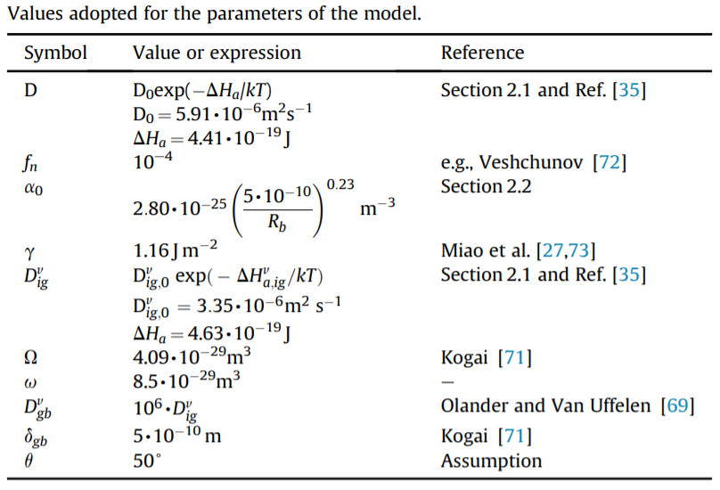



Experimental Procedure
Intra-granular swelling
Inter-granular swelling
V is the bubble volume
r_{gr} is the grain radius
N_{gf} is bubble number density
Thermal FGR is modeled based on a principle of grain boundary saturation
A_{gf}: bubble projected area on the grain face
Bubble growth is compensated by gas release in order to maintain the constant coverage condition.

Slide 6
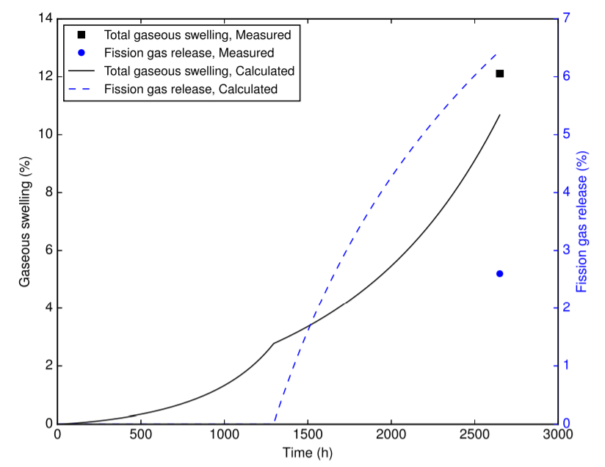
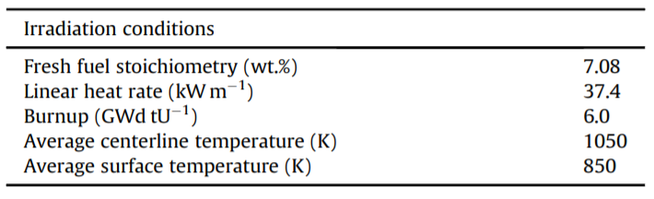
Results
Irradiation experiment simulation
Irradiation conditions for AI-7-1 experiment
FGR exhibits an incubation behavior, with no release being observed until the grain-boundary bubble coverage attains a saturation level.
Change of the swelling rate can be observed at the onset of FGR.
FGR comparison is not fully consistent, as the calculation refers to the centerline (hottest) portion of the specimen only. As expected, FGR is thus over-estimated.

Slide 7
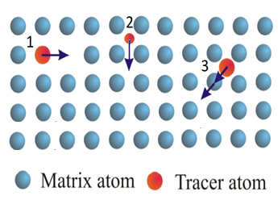
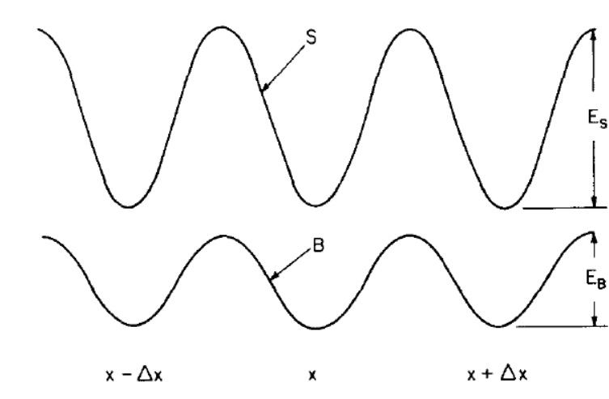
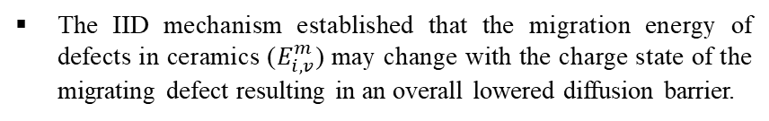
Critique
In the calculation of the diffusivity of the Xe and vacancies in U₃Si₂ the authors only considered a vacancy diffusion mechanism.
There are others diffusion mechanism that might play an important role.
In the article, only the fastest diffusion rate for Xe and uranium vacancies was analyzed.
The authors neglected RED which can drastically influence the diffusivity of the atoms under irradiation.
The authors failed to acknowledge and to discuss other processes that influenced diffusion in ionic irradiated crystal such as the Ionization Induced Diffusion Mechanism.
The IID mechanism established that the migration energy of defects in ceramics ($E_{i,v}^{m}$) may change with the charge state of the migrating defect resulting in an overall lowered diffusion barrier.
S and B different charge states
Bourgoin, J. C., et al. (1973). "Ionization enhanced diffusion." The Journal of Chemical Physics 59(8): 4042-404
7

Slide 8
Critique
Possible changes in the stichometry of the fuel are not included in the model proposed by the authors
The O/M ratio might change due to:
Oxygen liberation by fission
Reaction of oxygen fission products and cladding
Fission products produced with M³⁺ valance state incorporated in fuel lattice
The vacancy formation energy, Xe diffusion and FGR can highly be impacted by the stichometry of the fuel.
The model proposed by the authors made estimation for the intra-granular re-solution rate however the inter-granular re-solution calculation was totally neglected.
8

Slide 9
Thank You !
Questions ?

Slide 10
Backup Slides

Slide 11
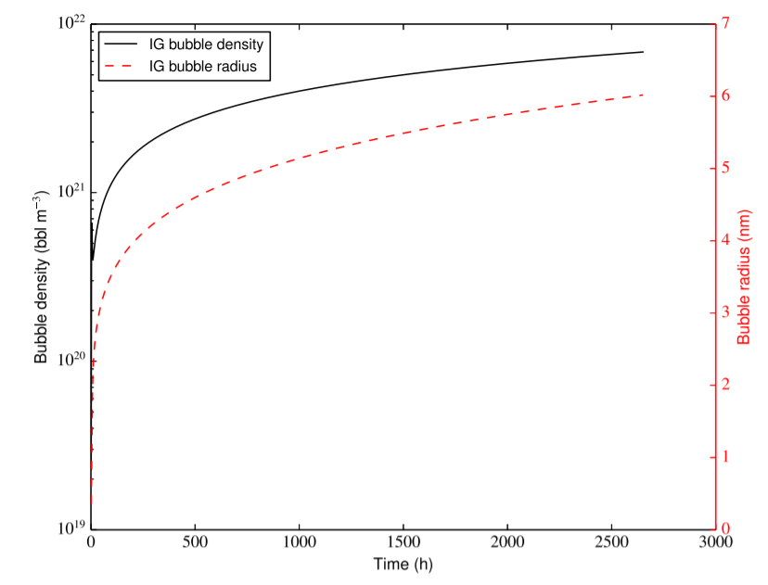
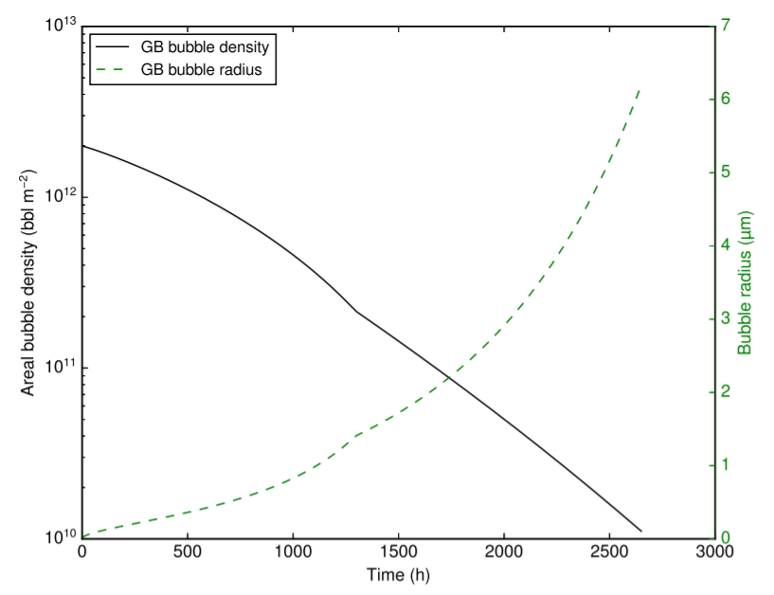
Results
Intra-granular bubbles
Lower number density and a higher radius of intra-granular bubbles compared to UO₂ under operational LWR conditions.
This appears consistent with the higher diffusivities of gas atoms and vacancies in U₃Si₂ compared to UO₂.
Inter-granular bubbles
The decrease in the bubble density is due to the progressive bubble coalescence during growth. Correspondingly, the bubble radius increases.

Slide 12
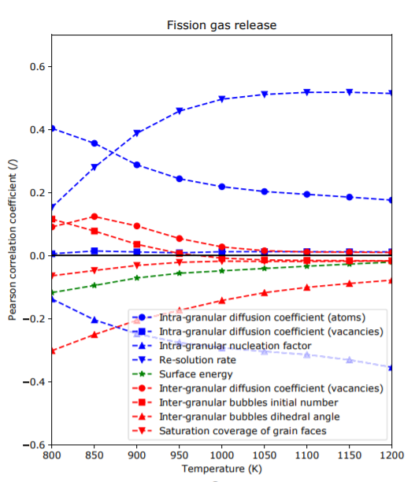
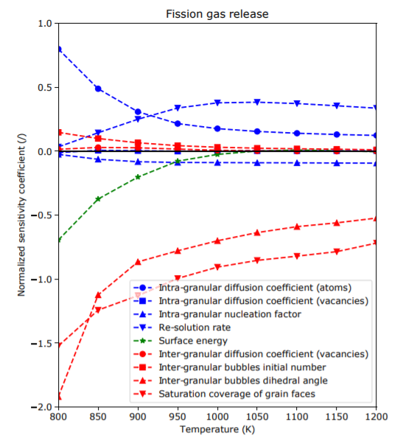
Results
Sensitivity analysis
The Pearson coefficient indicates how strong the correlation of a certain parameter is with respect to the chosen figure of merit.
The normalized sensitivity coefficient provides a measure of the relative variation of the figure of merit with respect to the variation of a specific parameter.
Low impact
Low impact

Slide 13
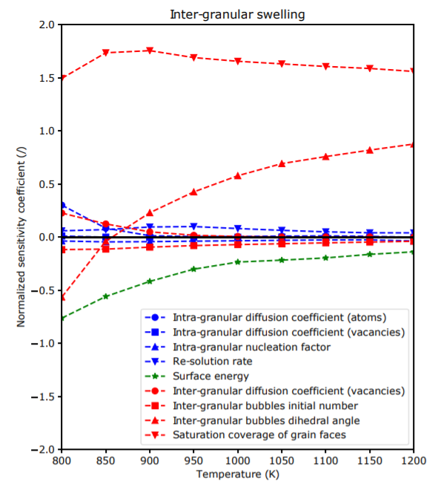
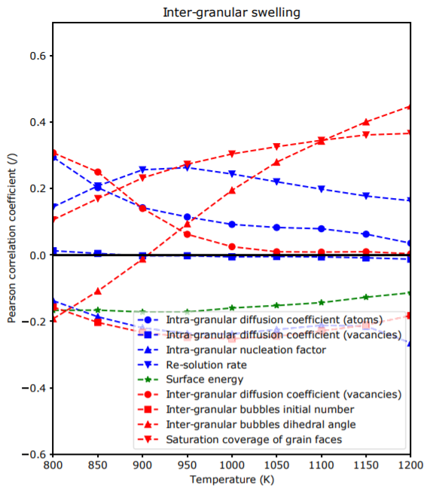
Results

Slide 14
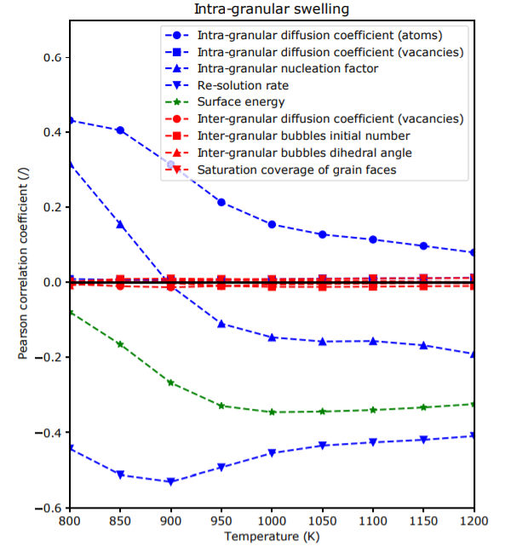
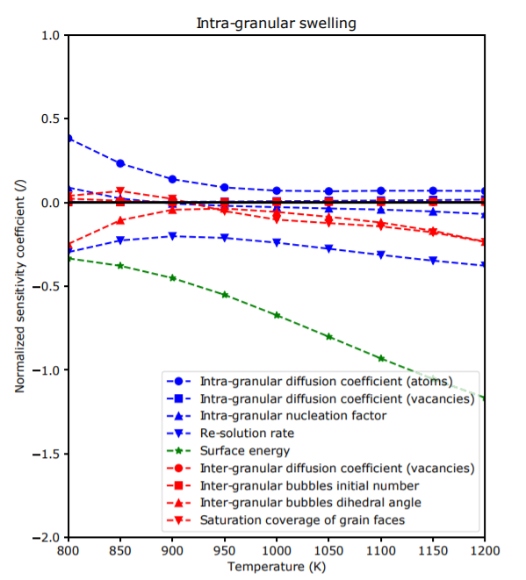
Results

Slide 15
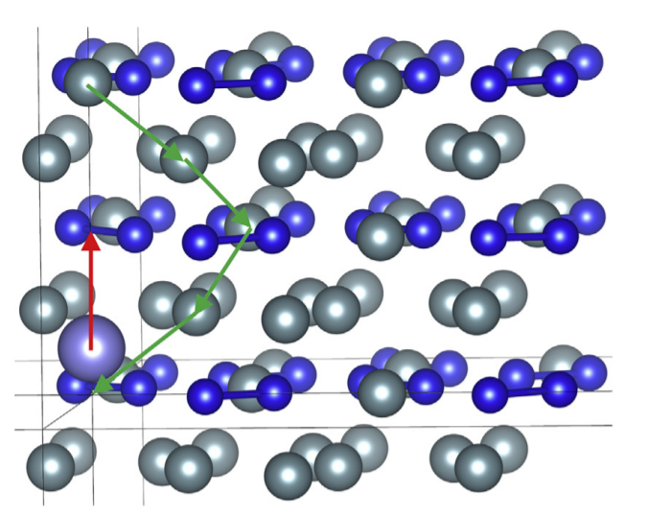
Density functional theory calculations of defects and fission gas properties
The authors only considered the fastest diffusion rate of Xe and uranium vacancies. For both of these species, the highest diffusivity is obtained for vacancy mechanisms along the c axis.
v: attempt frequency (s⁻¹ ),
a: jump distance (m)
Z: number of sites available for the Xe atom or vacancy to jump to,
G_{a}: activation free energy given by the migration enthalpy and the defect formation and binding energies and entropies (eV)
Xe diffusion mechanism in U₃Si₂ involving a Xe atom in a uranium vacancy trap site and a second uranium vacancy assisting diffusion in the c direction.
The resulting activation energies and preexponential factors were approximated based on experience from other materials such as UO₂

Slide 16
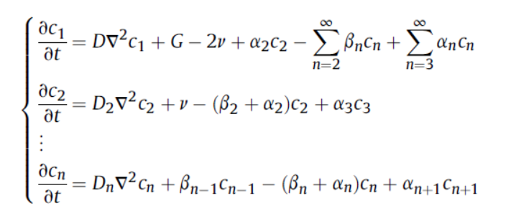
Experimental Procedure
Intra-granular fission gas behavior model
G: production rate of gas atoms
ν: nucleation rate of fission gas dimers →
D is the diffusion coefficient of single gas atoms in the fuel matrix, R_{sg} is the radius of a gas atom, and f_{n} is the nucleation factor.
$β_{n}$: probability per second that a single atom is trapped by a cluster containing n atoms
D is the single gas atom diffusion coefficient in the fuel matrix, R_{n} is the cluster size, and c₁ is the concentration of atoms in the matrix
α_{n} represents the probability per second that an atom is re-solved from a cluster containing n atoms
α₀ is a coefficient, which can in principle depend on the cluster size
Considering that homogeneous nucleation is consistently considered as a process of formation of dimers rather than at the average bubble size
N: total concentration of bubbles
ɸ= c₂/N represents the fraction of dimers over the total number of bubbles
m: total concentration of gas in bubbles

Slide 17


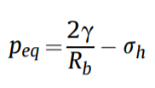

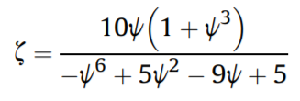
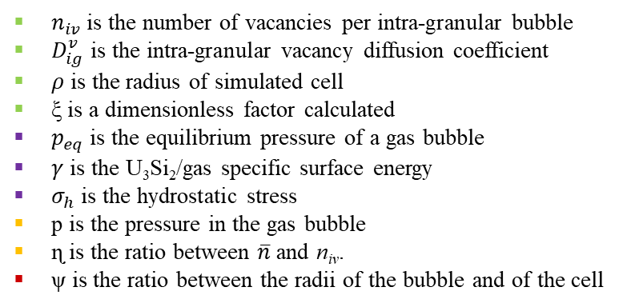
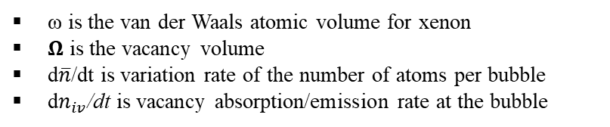
Experimental Procedure
Intra-granular fission gas behavior model
ω is the van der Waals atomic volume for xenon
𝛀 is the vacancy volume
d$\overline{n}$/dt is variation rate of the number of atoms per bubble
d$n_{iv}$/dt is vacancy absorption/emission rate at the bubble
$n_{iv}$is the number of vacancies per intra-granular bubble
$D_{ig}^{v}$ is the intra-granular vacancy diffusion coefficient
𝜌 is the radius of simulated cell
ξ is a dimensionless factor calculated
$p_{eq}$ is the equilibrium pressure of a gas bubble
$γ$ is the U₃Si₂/gas specific surface energy
$σ_{h}$ is the hydrostatic stress
p is the pressure in the gas bubble
ɳ is the ratio between $\overline{n}$ and n_{iv}.
ψ is the ratio between the radii of the bubble and of the cell

Slide 18
Experimental Procedure
Inter-granular model
The absorption rate of gas at the grain-boundary bubbles is assumed to equal the arrival rate of gas at the grain boundaries.
All grain-boundary bubbles are considered to have, at any instant, equal size and equal lenticular shape of circular projection.
Re-solution of grain-boundary bubbles is neglected.
The fractional fuel volume change due to grain-boundary fission gas swelling can be estimated as:
V is the bubble volume
r_{gr} is the grain radius
N_{gf} is bubble number density
Thermal FGR is modeled based on a principle of grain boundary saturation
A_{gf}: bubble projected area on the grain face
Bubble growth is compensated by gas release in order to maintain the constant coverage condition.

Slide 19
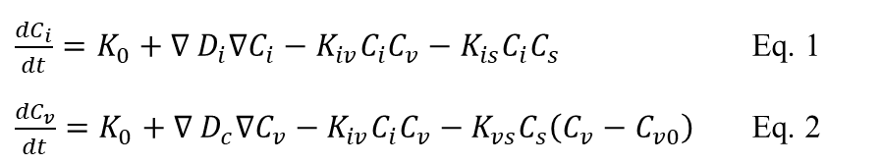
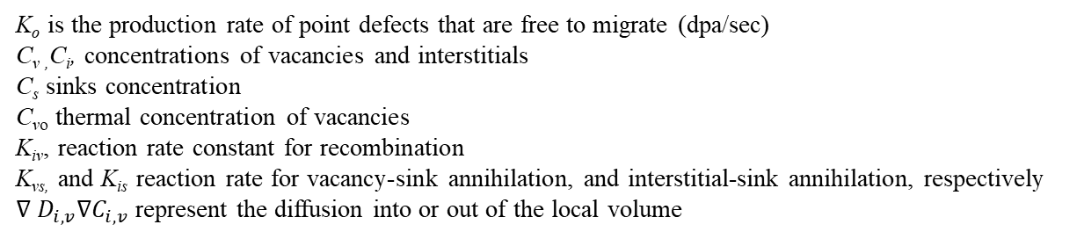
Radiation Enhanced Diffusion (RED)
Interstitial-Vacancy Recombination
Concentration Rate = Generation Rate- Loss Rate
Annihilation of point defects at sinks
$\frac{{dC}_{i}}{dt}=K_{0}+{∇ D}_{i}∇C_{i}−K_{iv}C_{i}C_{v}−K_{is}C_{i}C_{s}$ Eq. 1
$\frac{{dC}_{v}}{dt}=K_{0}+{∇ D}_{c}∇C_{v}−K_{iv}C_{i}C_{v}−K_{vs}C_{s}\left(C_{v}−C_{v0}\right)$ Eq. 2
K_{o} is the production rate of point defects that are free to migrate (dpa/sec)
C_{v ,}C_{i}, concentrations of vacancies and interstitials
C_{s} sinks concentration
C_{vo} thermal concentration of vacancies
K_{iv}, reaction rate constant for recombination
K_{vs,} and K_{is} reaction rate for vacancy-sink annihilation, and interstitial-sink annihilation, respectively
${∇ D}_{i,v}∇C_{i,v}$ represent the diffusion into or out of the local volume

